Slide 1
Before starting the training There are some things to consider.
Lucas Auer, Gabryelle Agoutin, Maria Bernard, Géraldine Pascal, Maëlle Pomiès & Olivier Rué

Slide 2



9 am (first day 8.45 am) to 5.30 pm
2 short coffee breaks morning and afternoon
Lunch 12.30 am to 1.30 pm
J0
Get Started with Galaxy
To be done autonomously on galaxy platform
J1
Metabarcoding overview: the key concepts
FROGS Core
J2
FROGS Stat
J4
J3
FROGS Core
FROGS Core
FROGS Stat
A stand-alone application on a set of long read data
Barcode
Technical sources of noise and errors
Short reads
Long reads
Bioinformatics analysis
Presentation of the datasets
16S short-read processing
Data analysis
ASV (Swarm/DADA2)
Remove chimera
ASV filters
ITSX
Taxonomic affiliation
Phylogenetic tree building
Companion tools
Import data
Alpha diversity
Beta diversity
presentation of the datasets
read processing
Practical work
DesSeq analysis
FROGS Func
Predicting functional abundances based only on marker gene sequences
Apply all FROGS steps to the long-read dataset Find the parameters Analyze the outputs Understand the processes
between two croaks
Practical work
application of acquired knowledge to a small dataset
Autonomously

Slide 3
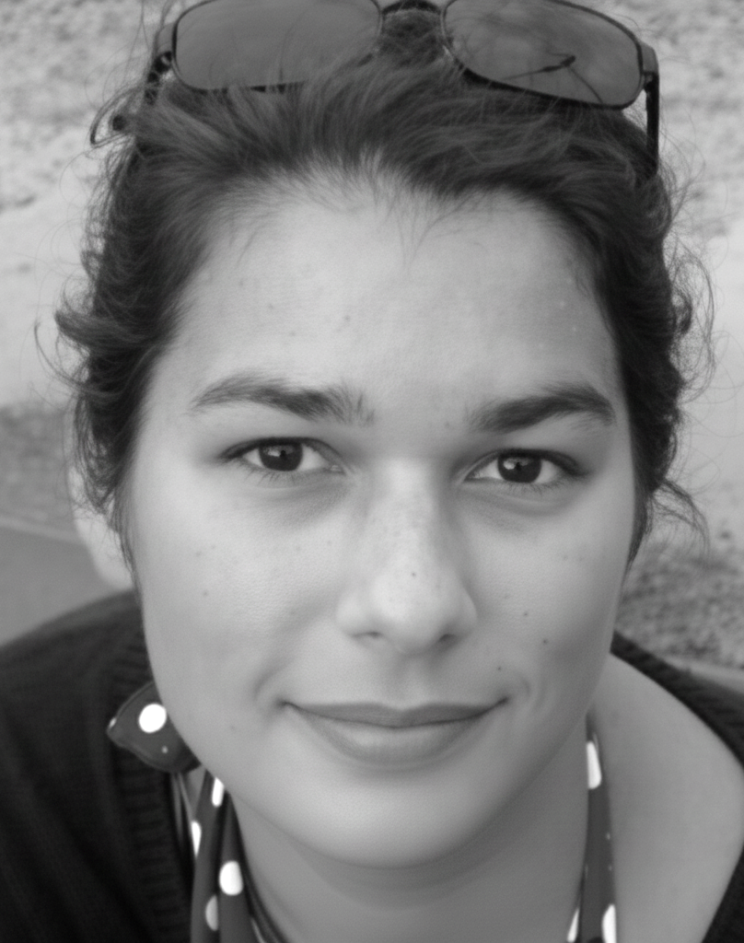

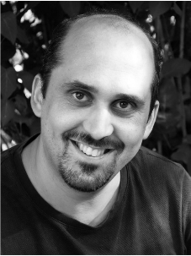



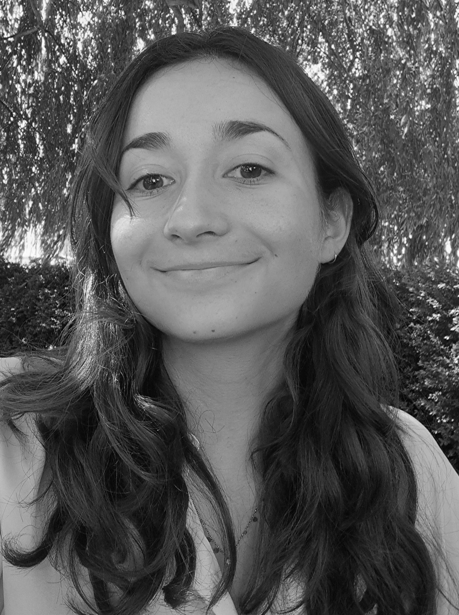
FROGS Teams
Biology and Statistical experts
Developers
Galaxy support
Maria Bernard
Olivier Rué
Lucas Auer
Patrice Déhais
Gabryelle Agoutin
Maelle Pomiès
Géraldine Pascal
Databank manager
Web master
Coordinator

Slide 4
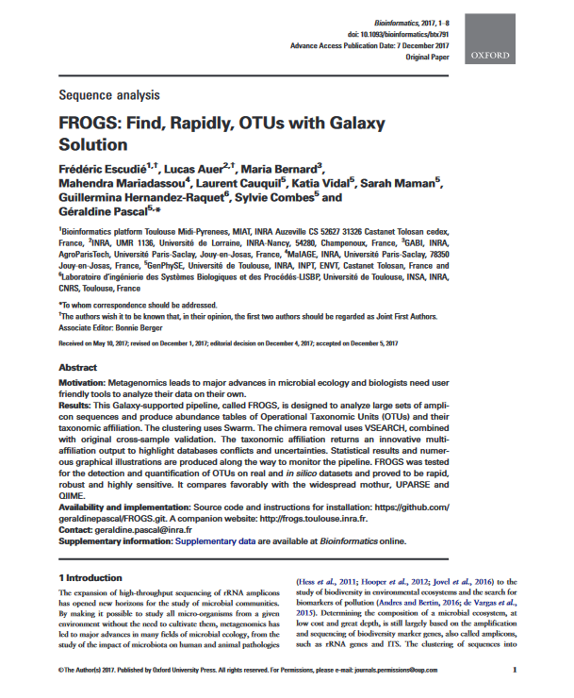
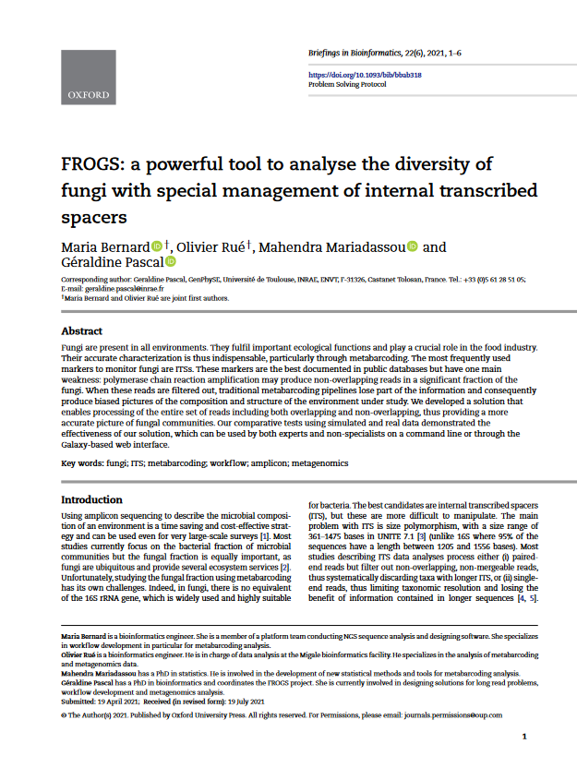
FROGS papers
Frédéric Escudié, Lucas Auer, Maria Bernard, Mahendra Mariadassou, Laurent Cauquil, Katia Vidal, Sarah Maman, Guillermina Hernandez-Raquet, Sylvie Combes, Géraldine Pascal.
"FROGS: Find, Rapidly, OTUs with Galaxy Solution." Bioinformatics, Volume 34, Issue 8, 15 April 2018, Pages 1287–1294
Maria Bernard, Olivier Rué, Mahendra Mariadassou and Géraldine Pascal; FROGS: a powerful tool to analyse the diversity of fungi with special management of internal transcribed spacers, Briefings in Bioinformatics 2021, 10.1093/bib/bbab318

Slide 5
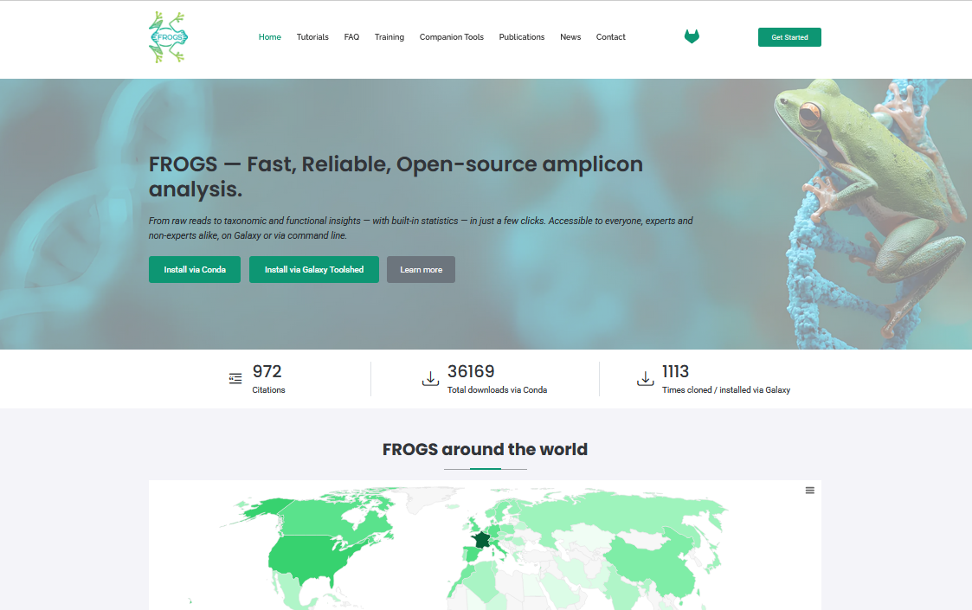
FROGS website
https://frogs.inrae.fr
Tutorials
FAQ
Training
Companion Tools
Publications
News
Contact

Slide 6
Contact us
https://frogs.inrae.fr/contact
FROGS support:
frogs-support@inrae.fr
Newsletter – subscription request:
frogs-support@inrae.fr

