Slide 1
Analysis of community composition data using phyloseq
mAHENDRA mARIAdAssou, maria bernard, geraldine pascal, lAURENT caUQUIL, STEPHANE CHAILLOU

Slide 2
Goals
Learn about and become familiar with phyloseq R package for the analysis of microbial census data
Exploratory Data Analysis
α-diversity: how diverse is my community?
β-diversity: how di erent are two communities?
Use a distance matrix to study structures:
Hierarchical clustering: how do the communities cluster?
Permutational ANOVA: are the communities structured by some known environmental factor (pH, height, etc)?
Visual assessment of the data
bar plots: what is the composition of each community?
Multidimensional Scaling: how are communities related?
Heatmaps: are there interactions between species and (groups of) communities?

Slide 3
Training Data
Training data come from a real analysis provided by Stéphane Chaillou et al.
The aim was to compare meat (4 types) and seafood (4 types) bacterial communities.
We use here, an extract of these public data :
64 samples of 16S V1-V3
From 8 environment types :
Meat ➔ Ground Beef, Ground veal, Poultry sausage, Diced bacon
Seafood ➔ Cooked schrimps, Smoked salmon, Salmon filet, Cod filet
508 OTUs affiliated with the Greengenes database
Chaillou, S. et al (2015). Origin and ecological selection of core and food-specific bacterial communities associated with meat and seafood spoilage. ISME J, 9(5):1105-1118.

Slide 4
Training Data
Take a look at the data:
data/chaillou/otu_table.tsv
CDT0#LOT06 CDT0#LOT09 CDT0#LOT07 CDT0#LOT02
otu_00601 0 0 0 4
otu_01717 0 4 37 5
data/chaillou/tax_table.tsv
Kingdom Phylum Class Order …
otu_00001 Bacteria Proteobacteria Gammaproteobacteria Pseudomonadales …
otu_00004 Bacteria Proteobacteria Gammaproteobacteria Pseudomonadales …

Slide 5
Training Data
Take a look at the data:
data/chaillou/sample_data.tsv
SampleID EnvType Description FoodType
BHT0.LOT01 BHT0#LOT01 BoeufHache LOT1 Meat
BHT0.LOT03 BHT0#LOT03 BoeufHache LOT3 Meat
data/chaillou/tree.nwk
(((((((((((((otu_00520:0.016,otu_00555:0.01122):0.01094,((otu_00568:0.00301,otu_00566:0.01354):0.00617,otu_00569:0.00821):0.00998):0.00828,otu_00545:0.03879):0.02824,((otu_00527:0.02225,otu_00521:0.00934): …

Slide 6
Phyloseq

Slide 7
Phyloseq
About phyloseq
phyloseq data structure
Other accessors
Manipulating a phyloseq object: Filtering
Manipulating a phyloseq object: Smoothing
Manipulating a phyloseq object: Abundance counts
Importing a phyloseq object

Slide 8
About Phyloseq
R package (McMurdie and Holmes, 2013) to analyze community composition data in a phylogenetic framework
He uses other R packages:
Community ecology functions from vegan, ade4, picante
Tree manipulation from ape
Graphics from ggplot2
(Differential analysis from DESeq2)

Slide 9
About Phyloseq
Find help:
phyloseq comes with two vignettes
vignette("phyloseq-basics")
vignette("phyloseq-analysis")
The first one gives insights about data structure and data manipulation (Section 2), the second one about data analysis (Section 3 to 5).

Slide 10
Phyloseq : Let’s get started
First load the phyloseq package
library(phyloseq)
and some additional custom functions
source("https://raw.githubusercontent.com/mahendra-mariadassou/phyloseq-extended/master/load-extra-functions.R" )

Slide 11
Phyloseq : Data import
The biom format natively supports
otu count tables (required)
otu description
sample description
but each component can be stored in TSV files.
Other optional components must be stored in separate files
phylogenetic tree in Newick format
sequences in fasta format

Slide 12
Phyloseq : Data import
Import biom file (from FROGS or anywhere else)
biomfile <- "data/chaillou/chaillou.biom"
food1 <-import_biom(biomfile)
food1
## phyloseq-class experiment-level object
## otu_table() OTU Table: [ 508 taxa and 64 samples ]
## tax_table() Taxonomy Table: [ 508 taxa by 7 taxonomic ranks ]

Slide 13
Phyloseq : Data import
Add samples metadata (optional, these can be already stored in biom file)
sampledata <-read.csv("data/chaillou/sample_data.tsv", sep="\t", row.names = 1)
sample_data(food1) <- sampledata
food1
## phyloseq-class experiment-level object
## otu_table() OTU Table: [ 508 taxa and 64 samples ]
## sample_data() Sample Data: [ 64 samples by 4 sample variables ]
## tax_table() Taxonomy Table: [ 508 taxa by 7 taxonomic ranks ]

Slide 14
Phyloseq : Data import
Add phylogenetic tree (optional)
treefile <- read.tree("data/chaillou/tree.nwk")
phy_tree(food1) <- treefile
food1
## phyloseq-class experiment-level object
## otu_table() OTU Table: [ 508 taxa and 64 samples ]
## sample_data() Sample Data: [ 64 samples by 4 sample variables ]
## tax_table() Taxonomy Table: [ 508 taxa by 7 taxonomic ranks ]
## phy_tree() Phylogenetic Tree: [ 508 tips and 507 internal nodes ]

Slide 15
Phyloseq : Data import
More direct way, if sample metadata are in biom file
biomfile2 <- "data/chaillou/chaillou_with_sam_data.biom"
treefile <- read.tree("data/chaillou/tree.nwk")
food <-import_biom(biomfile2, treefile, parseFunction = parse_taxonomy_greengenes)
food
## phyloseq-class experiment-level object
## otu_table() OTU Table: [ 508 taxa and 64 samples ]
## sample_data() Sample Data: [ 64 samples by 4 sample variables ]
## tax_table() Taxonomy Table: [ 508 taxa by 7 taxonomic ranks ]
## phy_tree() Phylogenetic Tree: [ 508 tips and 507 internal nodes ]

Slide 16
Phyloseq Data Structure
What information do we expect to find in food?
food
## phyloseq-class experiment-level object
## otu_table() OTU Table: [ 508 taxa and 64 samples ]
## sample_data() Sample Data: [ 64 samples by 3 sample variables ]
## tax_table() Taxonomy Table: [ 508 taxa by 7 taxonomic ranks ]
## phy_tree() Phylogenetic Tree: [ 508 tips and 507 internal nodes ]

Slide 17
Phyloseq Data Structure
Our phyloseq object food is made up of four parts:
OTU Table
Sample Data
Taxomony Table
Phylogenetic Tree
Let's have a quick look at each using the hinted at functions:
otu_table,
sample_data,
tax_table,
phy_tree.

Slide 18
Phyloseq Data Structure
OTU_table object is a matrix-like object
head(otu_table(food))
##OTU Table: [6 taxa and 64 samples]
## taxa are rows
## DLT0.LOT08 DLT0.LOT05 DLT0.LOT03 DLT0.LOT07 DLT0.LOT06 DLT0.LOT01 DLT0.LOT04 DLT0.LOT10
##otu_00520 0 0 0 0 0 0 0 0
##otu_00555 4 0 8 3 15 4 2 0
##otu_00568 0 0 0 0 0 0 0 0
##otu_00566 0 3 0 0 0 0 0 0
##otu_00569 12 3 26 16 38 0 4 0
##otu_00545 0 0 0 0 0 0 0 0
## MVT0.LOT05 MVT0.LOT01 MVT0.LOT06 MVT0.LOT07 MVT0.LOT03 MVT0.LOT09 MVT0.LOT08 MVT0.LOT10
##otu_00520 0 0 0 0 0 0 0 0
##otu_00555 12 17 25 31 11 40 12 4
##otu_00568 0 0 0 0 0 0 0 0
##otu_00566 0 0 0 0 0 0 0 0
##otu_00569 10 15 40 35 11 119 0 0

Slide 19
Phyloseq Data Structure
tax_table object is a matrix-like object
head(tax_table(food))
##Taxonomy Table: [6 taxa by 7 taxonomic ranks]:
## Kingdom Phylum Class Order Family
##otu_00520 "Bacteria" "Proteobacteria" "Gammaproteobacteria" "Enterobacteriales" "Enterobacteriaceae“
##otu_00555 "Bacteria" "Proteobacteria" "Gammaproteobacteria" "Enterobacteriales" "Enterobacteriaceae“
##otu_00568 "Bacteria" "Proteobacteria" "Gammaproteobacteria" "Enterobacteriales" "Enterobacteriaceae“
##otu_00566 "Bacteria" "Proteobacteria" "Gammaproteobacteria" "Enterobacteriales" "Enterobacteriaceae“
##otu_00569 "Bacteria" "Proteobacteria" "Gammaproteobacteria" "Enterobacteriales" "Enterobacteriaceae“
##otu_00545 "Bacteria" "Proteobacteria" "Gammaproteobacteria" "Enterobacteriales" "Enterobacteriaceae“
## Genus Species
##otu_00520 "Raoultella" "Ornithinolytica“
##otu_00555 "Hafnia-Obesumbacterium" "Alveii"
##otu_00568 "Serratia" "Fonticola"
##otu_00566 "Serratia" "Liquefaciens"
##otu_00569 "Serratia" "Proteamaculans"
➔ Try on food1

Slide 20
Phyloseq Data Structure
Sample_data object is a data.frame-like object
head(sample_data(food))
##Sample Data: [6 samples by 3 sample variables]:
## EnvType FoodType Description
##DLT0.LOT08 DesLardons Meat LOT8
##DLT0.LOT05 DesLardons Meat LOT5
##DLT0.LOT03 DesLardons Meat LOT3
##DLT0.LOT07 DesLardons Meat LOT7
##DLT0.LOT06 DesLardons Meat LOT6
##DLT0.LOT01 DesLardons Meat LOT1

Slide 21
Phyloseq Data Structure
Phy_tree object is a phylo_class(tree) object
phy_tree(food)
##Phylogenetic tree with 508 tips and 507 internal nodes.
Tip labels: otu_00520, otu_00555, otu_00568, otu_00566, otu_00569, otu_00545, ...
Rooted; includes branch lengths.

Slide 22
Phyloseq Data Structure
A phyloseq object is made of up to 5 components (or slots):
otu_table: an otu abundance table;
sample_data: a table of sample metadata, like sequencing technology, location of sampling, etc;
tax_table: a table of taxonomic descriptors for each otu, typically the taxonomic assignation at dierent levels (phylum, order, class, etc.);
phy_tree: a phylogenetic tree of the otus;
refseq: a set of reference sequences (one per otu), not present in food.

Slide 23
Phyloseq Data Structure
Phyloseq objects
Functions to access objects

Slide 24
Phyloseq : accessors
Phyloseq also offers the following accessors to extract parts of a phyloseq object.:
ntaxa / nsamples
sample_names / taxa_names
sample_sums / taxa_sums
rank_names
sample_variables
get_taxa
get_samples
get_variable
➔ Try them on your own (on food) and guess what they do.

Slide 25
Phyloseq : accessors
ntaxa(food)
## [1] 508
ntaxa returns the number of taxa;
nsamples(food)
## [1] 64
nsamples returns the number of samples;

Slide 26
Phyloseq : accessors
head(sample_names(food))
## [1] "DLT0.LOT08" "DLT0.LOT05" "DLT0.LOT03" "DLT0.LOT07" "DLT0.LOT06"
## [6] "DLT0.LOT01«
head(taxa_names(food))
## [1] "otu_00520" "otu_00555" "otu_00568" "otu_00566" "otu_00569" "otu_00545”
Names of the samples and taxa included in the phyloseq object.

Slide 27
Phyloseq : accessors
head(sample_sums(food))
## DLT0.LOT08 DLT0.LOT05 DLT0.LOT03 DLT0.LOT07 DLT0.LOT06 DLT0.LOT01
## 11812 11787 11804 11806 11832 11857
head(taxa_sums(food))
## otu_00520 otu_00555 otu_00568 otu_00566 otu_00569 otu_00545
## 55 395 22 13 1998 210
Total count of each sample (i.e. sample library sizes) or of each taxa (i.e.
overall abundances across all samples)

Slide 28
Phyloseq : accessors
rank_names(food)
## [1] "Kingdom" "Phylum" "Class" "Order" "Family" "Genus" "Species"
Names of the taxonomic levels available in the tax_table slot.
➔ Try on food1
head(sample_variables(food))
## [1] "EnvType" "FoodType" "Description"
Names of the contextual data recorded on the samples.

Slide 29
Phyloseq : accessors
Exercice: Find the
library size of samples MVT0.LOT01, MVT0.LOT07, MVT0.LOT09
overall abudance of otus otu_00520, otu_00569, otu_00527
Hint: What's the class of sample_sums(food) and taxa_sums(food)? How do you index them?
## sample library sizes
sample_sums(food)[c("MVT0.LOT01", "MVT0.LOT07", "MVT0.LOT09")]
## MVT0.LOT01 MVT0.LOT07 MVT0.LOT09
## 11743 11765 11739
## Otu overall abundances
taxa_sums(food)[c("otu_00520", "otu_00569", "otu_00527")]
## otu_00520 otu_00569 otu_00527
## 55 1998 58

Slide 30
Phyloseq : accessors
head(get_variable(food, varName = "EnvType"))
## [1] DesLardons DesLardons DesLardons DesLardons DesLardons DesLardons
## 8 Levels: BoeufHache VeauHache DesLardons MerguezVolaille ... Crevette
values for variable varName in sample data
head(get_sample(food, i = "otu_00520"))
## DLT0.LOT08 DLT0.LOT05 DLT0.LOT03 DLT0.LOT07 DLT0.LOT06 DLT0.LOT01
## 0 0 0 0 0 0
abundance values of otu i in all samples (row of OTU table).

Slide 31
Phyloseq : accessors
head(get_taxa(food, i = "MVT0.LOT07"))
## otu_00520 otu_00555 otu_00568 otu_00566 otu_00569 otu_00545
## 0 31 0 0 35 0
abundance values of all otus in sample i (column of OTU table)

Slide 32
Phyloseq : accessors
Exercice: How to modify part of phyloseq objects?
Change, the taxonomic rank names in food1 object. Hint : use the (high level) accessors?
## desired rank names
new_rank <- c("Kingdom", "Phylum", "Class", "Order", "Family", "Genus", "Species")
## modify
colnames(tax_table(food1)) <- new_rank
## check
rank_names(food1) ## or head(tax_table(food1))
## [1] "Kingdom" "Phylum" "Class" "Order" "Family" "Genus" "Species"

Slide 33
Phyloseq : accessors
Exercice: How to modify part of phyloseq objects?
Change, the EnvType variable order to have meat products first and seafood second.
## desired order
correct.order <- c("BoeufHache", "VeauHache", "DesLardons« , "MerguezVolaille", "SaumonFume", "FiletSaumon« , "FiletCabillaud", "Crevette")
## modify
sample_data(food)$EnvType <- factor(sample_data(food)$EnvType,levels = correct.order)
## check
levels(get_variable(food, "EnvType"))
## [1] "BoeufHache" "VeauHache" "DesLardons" "MerguezVolaille"
## [5] "SaumonFume" "FiletSaumon" "FiletCabillaud" "Crevette"

Slide 34
Phyloseq : accessors
Exercice: How to modify part of phyloseq objects?
modify the count of OTU "otu_00520" in sample "DLT0.LOT08“, or its species affiliation?
## change abundance of "otu_00520" in sample "DLT0.LOT08" to 0
otu_table(food)["otu_00520", "DLT0.LOT08"] <- 0
## change species affiliation of "otu_00520" to "Ornithinolytica"
tax_table(food)["otu_00520", "Species"] <- "Ornithinolytica"

Slide 35
Phyloseq Data Structure
Additionnal accessor functions

Slide 36
Phyloseq : Filtering Functions
Prune
prune_taxa /prune_samples prunes unwanted taxa /samples from a phyloseq object based on a vector of taxa to keep
The taxa are passed as a vector taxa of character (“otu1”, “otu4”) or of logical (TRUE, FALSE, FALSE, TRUE)
Example : prune_taxa(taxa, physeq_obj) would keep only otus otu1, otu4
Subset
subset_taxa / subset_samples subsets unwanted taxa / samples from a phyloseq object based on conditions that must be met
The conditions (any number) can apply to any descriptor (e.g. taxonomy) of the otus included in the phyloseq object physeq
subset taxa(physeq_obj, Phylum == "Firmicutes") would keep only Firmicutes.

Slide 37
Phyloseq : Filtering Functions
Exercice : Prune
Keep only the first 10 samples of your phyloseq object food
samplesToKeep <- sample_names(food)[1:10]
prune_samples(samplesToKeep, food)
## phyloseq-class experiment-level object
## otu_table() OTU Table: [ 508 taxa and 10 samples ]
## sample_data() Sample Data: [ 10 samples by 3 sample variables ]
## tax_table() Taxonomy Table: [ 508 taxa by 7 taxonomic ranks ]
## phy_tree() Phylogenetic Tree: [ 508 tips and 507 internal nodes ]

Slide 38
Phyloseq : Filtering Functions
Exercice : Subset
Keep only samples that corresponds to "DesLardons" and "MerguezVolaille".
subset_samples(food, EnvType %in% c("DesLardons", "MerguezVolaille"))
## phyloseq-class experiment-level object
## otu_table() OTU Table: [ 508 taxa and 16 samples ]
## sample_data() Sample Data: [ 16 samples by 3 sample variables ]
## tax_table() Taxonomy Table: [ 508 taxa by 7 taxonomic ranks ]
## phy_tree() Phylogenetic Tree: [ 508 tips and 507 internal nodes ]

Slide 39
Phyloseq : Filtering Functions
Advanced exercice : Subset and Multiple conditions combined
Keep only samples with Phylum affiliation equal to Firmicutes and Class affiliation to Bacilli.
Hint : AND is coded by « & » and OR is coded by « | »
small.food <- subset_taxa(food, Phylum == "Firmicutes" & Class == "Bacilli")
head(tax_table(small.food)[ , c("Phylum", "Class", "Order")])
## Taxonomy Table: [6 taxa by 3 taxonomic ranks]:
## Phylum Class Order
## otu_00583 "Firmicutes" "Bacilli" "Lactobacillales"
## otu_00574 "Firmicutes" "Bacilli" "Lactobacillales"
## otu_00581 "Firmicutes" "Bacilli" "Lactobacillales"
## otu_00591 "Firmicutes" "Bacilli" "Lactobacillales"
## otu_00582 "Firmicutes" "Bacilli" "Lactobacillales"
## otu_00586 "Firmicutes" "Bacilli" "Lactobacillales"
## Unique combinations (Phylum, Class)
unique(tax_table(small.food)[ , c("Phylum", "Class")])
## Taxonomy Table: [1 taxa by 2 taxonomic ranks]:
## Phylum Class
## otu_00583 "Firmicutes" "Bacilli"

Slide 40
Phyloseq : Smoothing Functions
tax_glom agglomerates otus at a given taxonomic level. Finer taxonomic information is lost.
mergedData <- tax_glom(food, "Phylum")
ntaxa(mergedData) ## number of different phyla
## [1] 11
tax_table(mergedData)[1:2, c("Phylum", "Order", "Class")]
## Taxonomy Table: [2 taxa by 3 taxonomic ranks]:
## Phylum Order Class
## otu_01101 "Proteobacteria" NA NA
## otu_01152 "Actinobacteria" NA NA

Slide 41
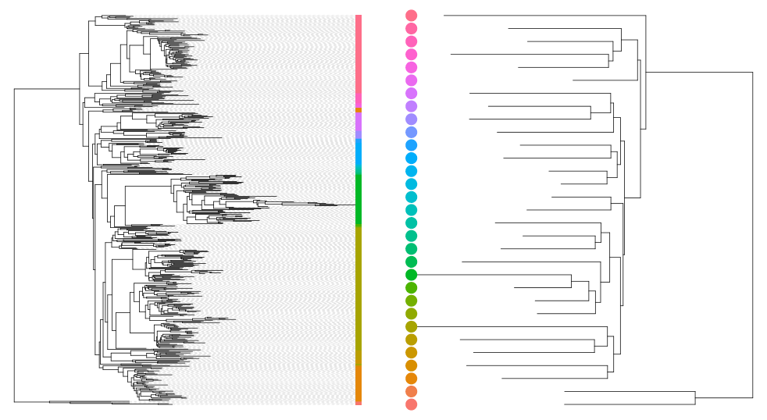
Phyloseq : Smoothing Functions
The effect of tax_glom is most obvious and best understood on the phylogenetic tree (otus are colored by phylum).

Slide 42
Phyloseq Data Structure
Additionnal editor functions

Slide 43
Phyloseq : Abundance manipulation
rarefy_even_depth downsamples/normalizes all samples to the same depth and prunes otus that disappear from all samples as a result.
foodRare <- rarefy_even_depth(food, rngseed = 1121983)
## `set.seed(1121983)` was used to initialize repeatable random
subsampling.
## Please record this for your records so others can reproduce.
## Try `set.seed(1121983); .Random.seed` for the full vector
## ...
## 1OTUs were removed because they are no longer
## present in any sample after random subsampling
sample_sums(foodRare)[1:5]
## DLT0.LOT08 DLT0.LOT05 DLT0.LOT03 DLT0.LOT07 DLT0.LOT06
## 11718 11718 11718 11718 11718

Slide 44
Phyloseq : Abundance manipulation
transform_sample_counts applies a function to the abundance vector of each sample. It can be useful for normalization.
count_to_prop <- function(x) {return( x / sum(x) )}
transforms counts to proportions.
foodTrans <- transform_sample_counts(food, count_to_prop)
sample_sums(foodTrans)[1:5] ## should be 1
## DLT0.LOT08 DLT0.LOT05 DLT0.LOT03 DLT0.LOT07 DLT0.LOT06
## 1 1 1 1 1

Slide 45
Phyloseq : in brief
A nice data structure to store the count table, taxonomic information, contextual data and phylogenetic tree as different components of a single R object .
Functions to import data from biom les, qiime output les or plain tabular files.
Accessors to access dierent component of your dataset
Samples and taxa names are coherent between the different components.
Filters to keep only part of the dataset.
Smoothers to aggregate parts of the dataset.
Manipulators to rarefy and transform samples

Slide 46
Phyloseq in brief
Phyloseq objects
Functions to access objects
Additionnal accessor and editor functions

Slide 47
Biodiversity analysis

Slide 48
Biodiversity analysis
Exploring the samples composition
Notions of biodiversity
α-diversity analysis
β-diversity analysis

Slide 49
Biodiversity analysis
visualization

Slide 50
Exploring biodiversity : visualization
p <- plot_bar(food)
plot(p) ## Base graphic, ugly

Slide 51
Exploring biodiversity : visualization
Organize samples and color otu by Phylum
## aes, fill bar according to phylum p <- plot_bar(food, fill = "Phylum")
## add facets p <- p + facet_wrap(~EnvType, scales = "free_x", nrow = 1)
plot(p)

Slide 52
Exploring biodiversity : visualization
➔ Limitations:
Plot bar works at the OTU-level...
...which may lead to graph cluttering and useless legends
No easy way to look at a subset of the data
Works with absolute counts (beware of unequal depths)

Slide 53
Exploring biodiversity : visualization
Customization: plot_composition function
subset otus at a given taxonomic level
aggregate otus at another taxonomic level
Show only a given number of otus (default the 10 most abundant).
Works with relative abundances
Example : Select Bacteria (at Kingdom level) and aggregate by Phylum.
p <- plot_composition(food, "Kingdom", "Bacteria", "Phylum“, numberOfTaxa = 5, fill = "Phylum")
p <- p + facet_wrap(~EnvType, scales = "free_x", nrow = 1)
plot(p)

Slide 54
Exploring biodiversity : visualization
Example : Select Proteobacteria (at Phylum level) and aggregate by Family.
p <- plot_composition(food, "Phylum", "Proteobacteria", "Family", numberOfTaxa = 9, fill = "Family")
p <- p + facet_wrap(~EnvType, scales = "free_x", nrow = 1)
plot(p)

Slide 55
Biodiversity analysis
Diversity indices

Slide 56
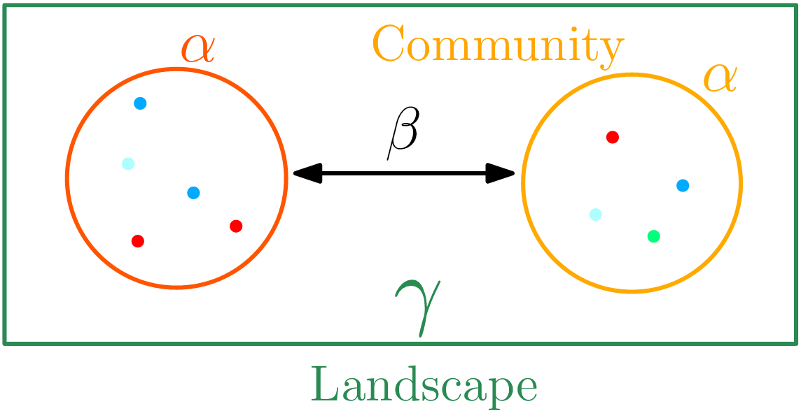
Exploring biodiversity : statistical indices
Second Step, compute and compare diversity indices. Three flavors of diversity:
α-diversity: diversity within a community;
β-diversity: diversity between communities;
β-dissimilarities/distances
Dissimilarities between pairs of communities
Often used as a first step to compute-diversity
γ-diversity: diversity at the landscape scale (blurry for bacterial communities);

Slide 57
Exploring biodiversity : statistical indices
Qualitative (Presence/Absence) vs. Quantitative (Abundance )
Qualitative gives less weight to dominant species;
Qualitative is more sensitive to differences in sampling depths;
Qualitative emphasizes difference in taxa diversity rather than differences in composition.
Compositional vs. Phylogenetic
Compositional does not require a phylogenetic tree;
is more sensitive to erroneous otu picking;
gives the same importance to all otus.

Slide 58
Biodiversity analysis
α-Diversity indices

Slide 59
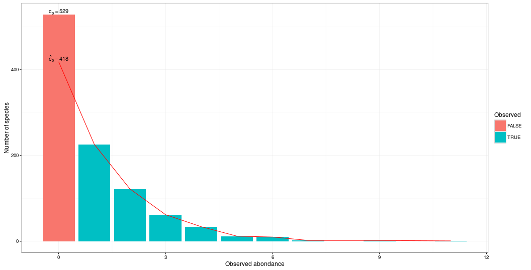
Exploring biodiversity : α-diversity
α-diversity is equivalent to the richness : number of species
Richness | Chao
Number of observed species | Richness + (estimated) number of unobserved species
Sreal = 1000
Schao = 889
Srich = 471

Slide 60
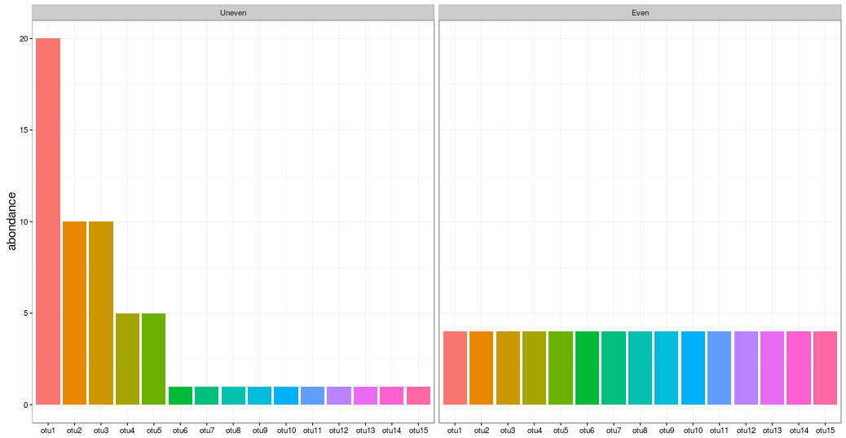
Exploring biodiversity : α-diversity
α-diversity is equivalent to the richness : number of species
Shannon | Inv-Simpson
Evenness of the species abundance distribution | Inverse probability that two sequences sampled at random come from the same species
Sinvsimp = 5,45
Sshan = log(7,85)
Srich = 15
Sinvsimp = 15
Sshan = log(15)
Srich = 15

Slide 61
Exploring biodiversity : α-diversity
α-diversity indices available in phyloseq :
Species richness : number of observed otus
Chao1 : number of observed otu + estimate of the number of unobserved otus
Shannon entropy / Jensen : the width of the otu relative abundance distribution. Roughly, it reflects our (in)ability to predict the otu of a randomly picked bacteria.
Simpson : 1 - probability that two bacteria picked at random in the community belong to different otu.
Inverse Simpson : inverse of the probability that two bacteria picked at random belong to the same otu.

Slide 62
Exploring biodiversity : α-diversity
Richness are plotted with plot_richness. Note the x = "EnvType " passed on to the aes mapping of a ggplot.
p <- plot_richness(food, color = "EnvType", x = "EnvType", measures = c("Observed", "Chao1", "Shannon", "Simpson", "InvSimpson"))
p <- p + geom_boxplot(aes(fill = EnvType), alpha=0.2)
plot(p)

Slide 63
Exploring biodiversity : α-diversity

Slide 64
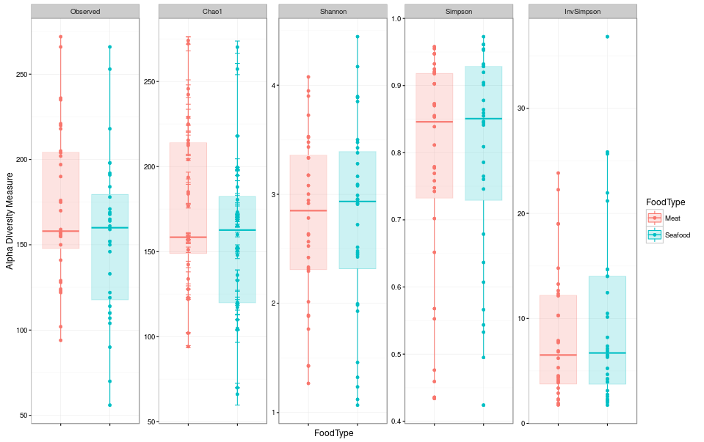
Exploring biodiversity : α-diversity
Try with FoodType instead of EnvType

Slide 65
Exploring biodiversity : α-diversity
Numeric values of α-diversities are given by estimate_richness (used internally by plot_richness)
alpha.diversity <- estimate_richness(food, measures = c("Observed", "Chao1", "Shannon"))
head(alpha.diversity)
## Observed Chao1 se.chao1 Shannon
## DLT0.LOT08 210 210.0000 0.0000 2.016038
## DLT0.LOT05 221 254.7857 13.3895 1.798009
## DLT0.LOT03 226 226.0000 0.0000 3.455284
## DLT0.LOT07 221 221.0000 0.0000 2.982161
## DLT0.LOT06 278 278.0000 0.0000 3.209521
## DLT0.LOT01 281 281.0000 0.0000 4.106852
write.table(alpha.diversity, "myfile.txt")

Slide 66
Exploring biodiversity : α-diversity
A quick ANOVA : tests if observed richness is significantly different in function of EnvType
data <- cbind(sample_data(food), alpha.diversity)
food.anova <- aov(Observed ~ EnvType, data)
summary(food.anova)
## Df Sum Sq Mean Sq F value Pr(>F)
## EnvType 7 86922 12417 12.49 1.63e-09 ***
## Residuals 56 55686 994
## ---
## Signif. codes: 0 *** 0.001 ** 0.01 * 0.05 . 0.1 1
There is a significant effect of environment type on richness

Slide 67
Exploring biodiversity : α-diversity
A quick ANOVA : tests if Shannon indices is significantly different in function of EnvType
food.anova <- aov(Shannon ~ EnvType, data)
summary(food.anova)
## Df Sum Sq Mean Sq F value Pr(>F)
## EnvType 7 7.98 1.139 1.767 0.112
## Residuals 56 36.12 0.645
EnvType effect on Shannon diversity is not significant

Slide 68
Exploring biodiversity : α-diversity
Interpretation
Many taxa observed in Deslardons (high Chao1, high Observed)…
...but low Shannon and Inverse-Simpson
communities dominated by a few abundant taxa
Environments differ a lot in terms of richness...
...but not so much in terms of Shannon diversity
Effective diversities are quite similar

Slide 69
Exploring biodiversity : α-diversity
WARNING : Many diversities (richness, Chao) depend a lot on rare otus. Do not trim rare otus before computing them as it can drastically alter the result.
α-diversity: without (left) and with (right) trimming on rare OTU ( total abundance < 500)

Slide 70
Biodiversity analysis
β-Diversity indices

Slide 71
Exploring biodiversity : β-diversity
Many diversities (both compositional and phylogenetic) offered by Phyloseq through the generic distance function.
Different dissimilarities capture different features of the communities:
qualitatively, communities are very similar
quantitatively they are very different
phylogeneticaly two communities seems to be closer than the third one.

Slide 72
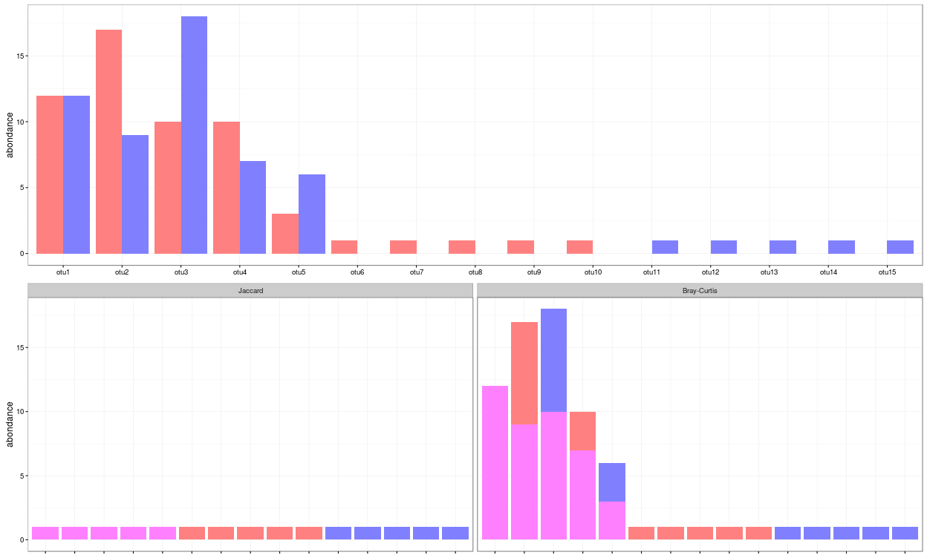
Exploring biodiversity : β-diversity
Jaccard | Bray-Curtis
Fraction of species specific to either 1 or 2 | Fraction of the community specific to 1 or to 2
D_{jac} = 0,667
D_{bc} = 0,281

Slide 73
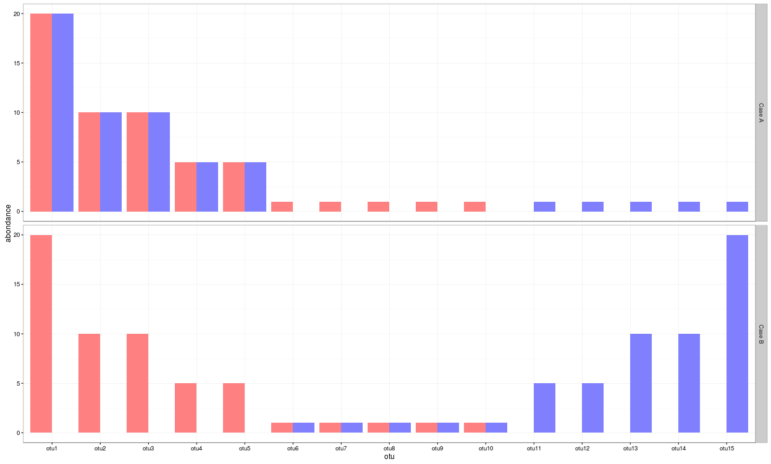
Exploring biodiversity : β-diversity
Jaccard | Bray-Curtis
Fraction of species specific to either 1 or 2 | Fraction of the community specific to 1 or to 2
D_{bc} = 0,091
D_{jac} = 0,667
D_{bc} = 0,909
D_{jac} = 0,667

Slide 74
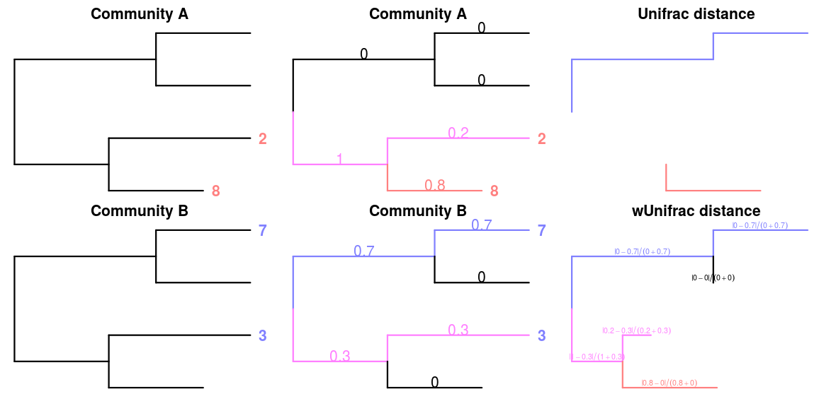
Exploring biodiversity : β-diversity
Unifrac | Weigthed-Unifrac
Fraction of the tree specific to either 1 or 2 | Fraction of the diversity specific to 1 or to 2
If all branch length are equal to 1, only branch present in at least one community are taken into account :

Slide 75
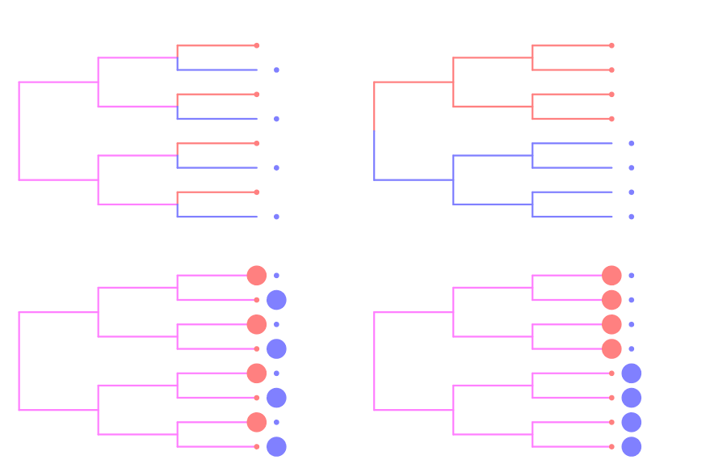
Exploring biodiversity : β-diversity
What do you conclude in terme of Jaccard, Bray Curtis, Unifrac and weigthed Unifrac values?

Slide 76
Exploring biodiversity : β-diversity

Slide 77
Exploring biodiversity : β-diversity
Dissimilarities are computed with distance
dist.bc <- distance(food, method = "bray") ## Bray-Curtis
All available distances are available with
distanceMethodList
## $UniFrac
## [1] "unifrac" "wunifrac"
## $DPCoA
## [1] "dpcoa"
## $JSD
## [1] "jsd"
## $vegdist
## [1] "manhattan" "euclidean" "canberra" "bray" "kulczynski " "jaccard" "gower" "altGower" "morisita" "horn"
## [11] "mountford" "raup" "binomial" "chao" "cao"
## $betadiver
## [1] "w" "-1" "c" "wb" "r" "I" "e" "t" "me" "j" "sor" ...

Slide 78
Exploring biodiversity : β-diversity
Bray-Curtis, Jaccard and Kulczynski good at detecting underlying ecological gradients
Morisita-Horn, Cao and Jensen-Shannon good at handling different sample sizes
All take value in [0; 1] except JSD and Cao.

Slide 79
Exploring biodiversity : β-diversity
β-diversity indices can be visualized thanks to heatmap.
## custom function to implement
p <- plot_dist_as_heatmap(dist.bc, title = "Bray-Curtis")
plot(p)

Slide 80
Exploring biodiversity : β-diversity
Jaccard lower than Bray-Curtis
abundant taxa are not shared
Jaccard higher than Unifrac
communities' taxa are distinct but phylogenetically related
Unifrac higher than weighted Unifrac
abondant taxa in both communities are phylogenetically close.

Slide 81
Exploring biodiversity : β-diversity
In general, qualitative diversities are more sensitive to factors that affect presence/absence of organisms (such as pH, salinity, depth, etc) and therefore useful to study and define bioregions (regions with little of no ow between them)...
... whereas quantitative distances focus on factors that affect relative changes (seasonal changes, nutrient availability, concentration of oxygen, depth, etc) and therefore useful to monitor communities over time or along an environmental gradient.
Different distances capture different features of the samples.
There is no "one size fits all"

Slide 82
Exploring the structure

Slide 83
Exploring the structure
ordination

Slide 84
Exploring the structure : ordination
Each community is described by otus abundances
Otus abundance maybe correlated
PCA finds linear combinations of otus that
are uncorrelated
capture well the variance of community composition
But variance is not a very good measure of β-diversity

Slide 85
Exploring the structure : ordination
The Multidimensionnal Scaling (MDS or PCoA) is equivalent to a principal component Analysis (PCA) but preserves the β-diversity instead of the variance.
The MDS try to represent samples in two dimensions
➔ The samples ordination.
 | Distance Matrix
 | S1 | S2 | S3 | S4 | S5
S1 | 0.00 | 2.21 | 6.31 | 0.99 | 7.50
S2 | 2.21 | 0.00 | 5.40 | 1.22 | 5.74
S3 | 6.31 | 5.40 | 0.00 | 5.75 | 3.16
S4 | 0.99 | 1.22 | 5.75 | 0.00 | 6.64
S5 | 7.50 | 5.74 | 3.16 | 6.64 | 0.00

Slide 86
Exploring the structure : ordination
Ordination is done through the ordinate function.
You can pass the distance either by name (and phyloseq will call distance) :
ord <- ordinate(food, method = "MDS", distance = "bray")
or by passing a distance matrix directly (useful if you already computed it)
dist.bc <- distance(food, method = "bray")
ord <- ordinate(food, method = "MDS", distance = dist.bc)

Slide 87
Exploring the structure : ordination
The graphic is then produced with plot_ordination
p <- plot_ordination(food, ord, color = "EnvType")
## add title and plain background
p <- p + theme_bw() + ggtitle("MDS + BC")
plot(p)

Slide 88
Exploring the structure : ordination
Custom plot_samples function built around plot ordination to represent groups (extra replicate parameter)
p <- plot_samples(food, ord, color = "EnvType", replicate = "EnvType")
p <- p + theme_bw() + ggtitle("MDS + BC")
plot(p)

Slide 89
Exploring the structure : ordination

Slide 90
Exploring the structure : ordination
Qualitative distances (Unifrac, Jaccard) separate meat products from seafood ones ➔ detected taxa segregate by origin.
DesLardons is somewhere in between ➔ contamination induced by sea salt.
Quantitative distances (wUnifrac) exhibit a gradient meat – seafood (on axis 1) with DesLardons in the middle and a gradient SaumonFume - everything else on axis 2.
Large overlap between groups in terms of relative composition but less so in term of species composition (a side e ect of undersampling?)
Note the difference between wUniFrac and Bray-Curtis for the distances between BoeufHache and VeauHache
Warning The 2-D representation captures only part of the original distances.

Slide 91
Exploring the structure
clustering

Slide 92
Exploring the structure : clustering
The clustering aims to represent samples in a tree based on a distance matrix and a linkage function:
Complete linkage: tends to produce compact, spherical clusters and guarantees that all samples in a cluster are similar to each other.
Ward: tends to also produces spherical clusters but has better theoretical properties than complete linkage.
single: friend of friend approach, tends to produce banana-shaped or chains-like clusters.

Slide 93
Exploring the structure : clustering
Choose a distance (among Jaccard, Bray-Curtis, Unifrac, etc)
Choose a linkage function
complete (“complete”): tends to produce compact, spherical clusters and guarantees that all samples in a cluster are similar to each other.
ward (“ward.D2”): tends to also produces spherical clusters but has better theoretical properties than complete linkage.
single (“single”): friend of friend approach, tends to produce banana-shaped or chains-like clusters.
Feed to hclust and plot
clustering <- hclust(distance.matrix, method = "linkage.function")
plot(clustering)

Slide 94
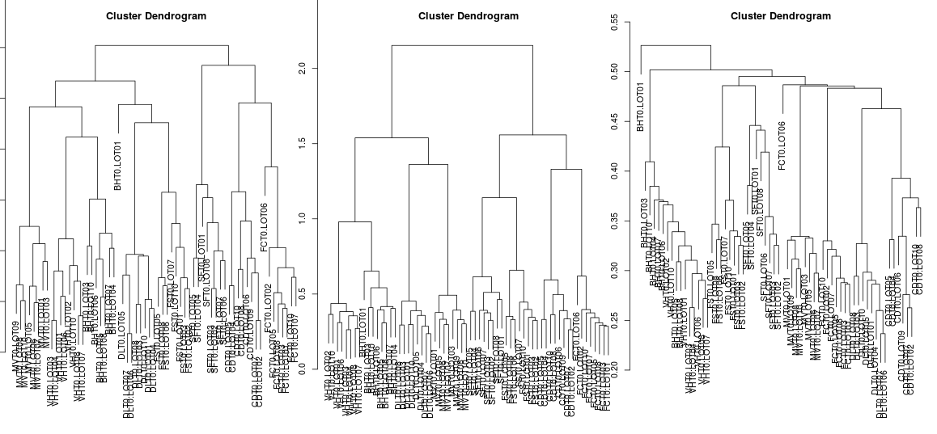
Exploring the structure : clustering
par(mfcol = c(1, 3)) ## To plot the three clustering trees side-by-side
plot(hclust(dist.uf, method = "complete"))
plot(hclust(dist.uf, method = "ward.D2"))
plot(hclust(dist.uf, method = "single"))

Slide 95
Exploring the structure : clustering
With some effort (see companion R script), we can produce better dendrograms and color sample by food type (appreciate what ggplot does for you behind the hook).
## Env types
envtype <- get_variable(food, "EnvType")
## automatic color palette: one color per different sample type
palette <- hue_pal()(length(levels(envtype)))
## Map sample type to color
tipColor <- col_factor(palette, levels = levels(envtype))(envtype)
## Change hclust object to phylo object and plot
par(mar = c(0, 0, 2, 0))
dist.uf <- distance(food, method = "unifrac")## if not already done
clust.uf <- as.phylo(hclust(dist.uf, method = "complete"))
plot(clust.uf, tip.color = tipColor, direction = "downwards",
main = "Ward linkage"))

Slide 96
Exploring the structure : clustering
Crevette
FiletCabillaud
FiletSaumon
SaumonFume
MerguezVolaille
DesLardons
BoeufHache
VeauHache

Slide 97
Exploring the structure : clustering
Remarks
Consistent with the ordination plots, clustering works quite well for the UniFrac distance for some linkage (Ward)
Clustering is based on the whole distance whereas ordination represents parts of the distance (the most it can with 2 dimensions)

Slide 98
Exploring the structure
HEATMAP

Slide 99
Exploring the structure : Heatmap
The heatmap is an other representation of the distance matrix.
It try to reveal it there is a structure between group of OTU and group of samples.
plot_heatmap is a versatile function to visualize the count table.
Finds a meaningful order of the samples and the otus
Allows the user to choose a custom order
Allows the user to change the color scale
Produces a gpplot2 object, easy to manipulate and customize

Slide 100
Exploring the structure : Heatmap
p <- plot_heatmap(food)

Slide 101
Exploring the structure : Heatmap
p <- plot_heatmap(food, low = "yellow", high = "red", na.value = "white")
plot(p)

Slide 102
Exploring the structure : Heatmap
p <- plot_heatmap(food, low = "yellow", high = "red", na.value = "white")
p <- p + facet_grid(~EnvType, scales = "free_x")
plot(p)

Slide 103
Exploring the structure : Heatmap
p <- plot_heatmap(food)
p <- p + scale_fill_gradient2(low = "#1a9850", mid = "#ffffbf", high = "#d73027",
na.value = "white", trans = log_trans(4),
midpoint = log(100, base = 4))
p <- p + facet_grid(~EnvType, scales = "free_x")
plot(p)

Slide 104
Exploring the structure : Heatmap
Block-like structure of the abundance table
Interaction between (groups of) taxa and (groups of) samples
Core and condition-specic microbiota
➔ Classification of taxa and use of custom taxa order to highlight structure

Slide 105
Diversity partitioning

Slide 106
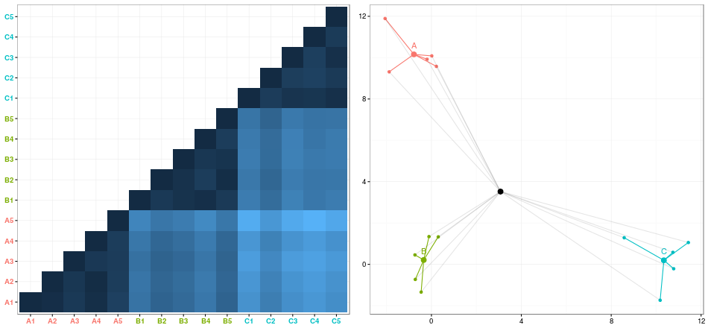
Diversity partitioning
Are the structures seen linged to metadata ? Do the metadata have an effect on our communities composition ?
To answer these questions, multivariate analyses that :
tests composition differences of communities from different groups using a distance matrix
compares within group to
between group distances

Slide 107
Diversity partitioning : CAP
Constrained Analysis of Principal Coordinates (CAP) tries to :
Find associations between community composition and environmental variables (pH, group)
Quantify differences between groups of samples
How it works : Regress a distance matrix against some covariates using the standard R syntax for linear models.
Project distance matrix on metadata variables ➔ communities are constrained to depend on metadata
Look if constrained distance fit to non constrained distance.
## convert sample_data to data.frame
metadata <- as(sample_data(food), "data.frame")
cap <- capscale(dist.uf ~ EnvType, data = metadata)
Notes:
Une autre façon de le comprendre : je mesure la différence entre toutes les personnes qui sont présentes dans la salle. Cela me fait beaucoup de différence deux à deux.
À partir des distances, je calcule des positions pour tous les individus de la salle.
Je force les positions à ne dépendre que du lieu d'origine des personnes.
Quand cela ne dépend plus que du lieu d'origine, je recalcule les distances entre mes paires d'individus, et je regarde ce que j'ai perdu par rapport aux distances de départ.

Slide 108
Diversity partitioning : CAP
cap
## Call: capscale(formula = dist.uf ~ EnvType, data = metadata)
##
## Inertia Proportion Rank
## Total 12.1280
## Real Total 12.1600 1.0000
## Constrained 7.6570 0.6297 7
## Unconstrained 4.5030 0.3703 56
## Imaginary -0.0320 6
## Inertia is squared Unknown distance
##
## Eigenvalues for constrained axes:
## CAP1 CAP2 CAP3 CAP4 CAP5 CAP6 CAP7
## 2.5546 1.4630 1.1087 0.8954 0.7159 0.4940 0.4255
##
## Eigenvalues for unconstrained axes:
## MDS1 MDS2 MDS3 MDS4 MDS5 MDS6 MDS7 MDS8
## 0.4161 0.2908 0.2540 0.2111 0.2066 0.2011 0.1675 0.1562
## (Showed only 8 of all 56 unconstrained eigenvalues)
Environment type explains roughly 63% of the total variation between samples (as measured by Unifrac)

Slide 109
Diversity partitioning : CAP
## test the confidence of CAP
anova <- anova(cap, permutations = 999)
## Permutation test for capscale under reduced model
## Permutation: free
## Number of permutations: 999
##
## Model: capscale(formula = dist.uf ~ EnvType, data = metadata)
## Df Variance F Pr(>F)
## Model 7 7.6571 13.603 0.001 ***
## Residual 56 4.5032
## ---
## Signif. codes: 0 *** 0.001 ** 0.01 * 0.05 . 0.1 1

Slide 110
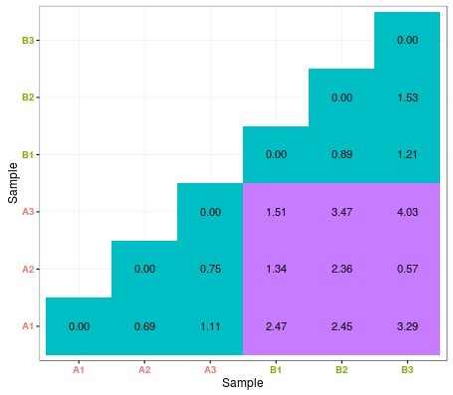
Diversity partitioning : Multivariate ANOVA
Idea : Test differences in the community composition of communities from different groups using a distance matrix.
How it works ?
No projection of distance matrix, but compute
sum of square distance
Variance analysis

Slide 111
Diversity partitioning : Multivariate ANOVA
metadata <- as(sample_data(food), "data.frame")
adonis(dist.uf ~ EnvType, data = metadata, perm = 9999)
##
## Call:
## adonis(formula = dist.uf ~ EnvType, data = metadata, permutations = 9999)
##
## Permutation: free
## Number of permutations: 9999
##
## Terms added sequentially (first to last)
##
## Df SumsOfSqs MeanSqs F.Model R2 Pr(>F)
## EnvType 7 7.6565 1.09379 13.699 0.63132 1e-04 ***
## Residuals 56 4.4713 0.07984 0.36868
## Total 63 12.1278 1.00000
## ---
## Signif. codes: 0 *** 0.001 ** 0.01 * 0.05 . 0.1 1
Environment type explains roughly 63% of the total variation.

Slide 112
Annexes

Slide 113
References
Chaillou, S., Chaulot-Talmon, A., Caekebeke, H., Cardinal, M., Christieans, S., Denis, C., Desmonts, M. H., Dousset, X., Feurer, C., Hamon, E., Joraud, J.-J., La Carbona, S., Leroi, F., Leroy, S., Lorre, S., Mace, S., Pilet, M.-F., Prevost, H., Rivollier, M., Roux, D., Talon, R., Zagorec, M., and Champomier-Verges, M.-C. (2015). Origin and ecological selection of core and food-specic bacterial communities associated with meat and seafood spoilage. ISME J, 9(5):1105{1118.
McMurdie, P. J. and Holmes, S. (2013). phyloseq: An r package for reproducible interactive analysis and graphics of microbiome census data. PLoS ONE, 8(4):e61217.
Shade, A., Jones, S. E., Caporaso, J. G., Handelsman, J., Knight, R., Fierer, N., and Gilbert, J. A. (2014). Conditionally rare taxa disproportionately contribute to temporal changes in microbial diversity. MBio, 5(4):e01371{e01314.

Slide 114
Installing Phyloseq
From bioconductor
## try http if https is not available
source("https://bioconductor.org/biocLite.R")
biocLite("phyloseq")
From developer's website
install.packages("devtools") ## If not installed previously
library("devtools")
install_github("phyloseq", "joey711")

Slide 115
Go further : phyloseq import
It is possible to build a phyloseq object from plain tabular files.
Since otus/sample names are not always consistent (unlike in a biom), some care must be taken.
Otherwise the phyloseq objects consists only of otus and samples with consistent names and may end up empty.
Import each component separately;
Convert to correct base R data type (matrix for otu_table and tax_table, data.frame for sample_data)
Convert to phyloseq data type (otu_table, tax_table, sample_data)
Check name consistency
Build phyloseq object

Slide 116
Go further : phyloseq import
Import each component
sampledata <- read.csv("data/manual/sampledata.tsv", sep = "nt", row.names = 1)
taxtable <- read.csv("data/manual/taxtable.tsv", sep = "nt", row.names = 1)
otutable <- read.csv("data/manual/otutable.tsv", sep = "nt", row.names = 1)
tree <- read.tree("data/manual/tree.phy")
Convert to base R type
taxtable <- as.matrix(taxtable)
otutable <- as.matrix(otutable)
Convert to phyloseq base type
sampledata <- sample_data(sampledata)
taxtable <- tax_table(taxtable)
otutable <- otu_table(otutable, taxa_are_rows = TRUE)

Slide 117
Go further : phyloseq import
Check name consistency
Abundance table and sample data (sample names)
all(colnames(otutable) %in% rownames(sampledata)) ## sample names
## [1] TRUE
Abundance table and taxonomy table (taxa names)
all(rownames(otutable) %in% rownames(taxtable)) ## taxa names
## [1] TRUE
Abundance table and tree leaves (taxa names)
all(rownames(otutable) %in% tree$tip.label) ## taxa names
## [1] TRUE

Slide 118
Go further : phyloseq import
Build object
manualData <- phyloseq(sampledata, otutable, taxtable, tree)
manualData
## phyloseq-class experiment-level object
## otu_table() OTU Table: [ 500 taxa and 26 samples ]
## sample_data() Sample Data: [ 26 samples by 6 sample variables ]
## tax_table() Taxonomy Table: [ 500 taxa by 7 taxonomic ranks ]
## phy_tree() Phylogenetic Tree: [ 500 tips and 499 internal nodes ]

Slide 119
Go further : phyloseq filters
Specify a sample wise, otu wide condition (e.g. abundance greater than 2, in the top ten otus, etc)
Specify a number of samples A
Select only otus satisfying condition in at least A samples (usually to prune them).
Examples (what do they do?)
condition <- function(x) { x > 0 }
taxaToKeep <- genefilter_sample(food, condition, 5)
prune_taxa(taxaToKeep, food)
condition <- function(x) {order(x, decreasing = TRUE) <= 250 }
taxaToKeep <- genefilter_sample(food, condition, 3)
prune_taxa(taxaToKeep, food)

Slide 120
Go further : phyloseq filters
First example
condition is TRUE if a taxa is present in a sample;
condition must be met 5 times;
➔ Select taxa that appear in at least 5 samples.
Second example
condition is TRUE if a taxa is among the 250 most abundant ones in the sample;
condition must be met 3 times;
➔ Select taxa that are very abundant (top 250) in at least 3 samples.

Slide 121
Go further : phyloseq filters
Specify an otu wise, sample wide on the otu abundance vector condition (e.g. overall abundance greater than 3, etc);
Selects only otus satisfying condition (usually to prune them)
Works on an otu-by-otu basis. Beware of bad normalizations.
Examples (what do they do?)
condition <- function(x) { sum(x > 0) >= 5 }
taxaToKeep <- filter_taxa(food, condition)
prune_taxa(taxaToKeep, food)
condition <- function(x) { sum(x) >= 100 }
taxaToKeep <- filter_taxa(food, condition)
prune_taxa(taxaToKeep, food)

Slide 122
Go further : phyloseq filters
First example
condition is TRUE if a taxa has at least 5 positive counts (across samples);
➔ Select taxa that appear in at least 5 samples;
Probably better done with genefilter_sample
Second example
condition is TRUE if a taxa has global abundance at least 100;
➔ Select taxa with overall abundance at least 100 (beware of unequal sample sizes).
Probably done better with sample_sums

Slide 123
Go further : phyloseq smoothing
merge_samples merges samples according to a factor by summing their abundances (beware of different group sizes and library sizes)
mergedData <- merge_samples(food, "EnvType")
## Warning in asMethod(object): NAs introduits lors de la conversion automatique
## Warning in asMethod(object): NAs introduits lors de la conversion automatique
mergedData
## phyloseq-class experiment-level object
## otu_table() OTU Table: [ 508 taxa and 8 samples ]
## sample_data() Sample Data: [ 8 samples by 3 sample variables ]
## tax_table() Taxonomy Table: [ 508 taxa by 7 taxonomic ranks ]
## phy_tree() Phylogenetic Tree: [ 508 tips and 507 internal nodes ]
sample_names(mergedData)
## [1] "BoeufHache" "VeauHache" "DesLardons" "MerguezVolaille"
## [5] "SaumonFume" "FiletSaumon" "FiletCabillaud" "Crevette"

Slide 124
Go further : phyloseq smoothing
Unfortunately, merging the contextual data is hard to do automatically in a meaningful way and information is lost in the process...
sample_data(mergedData)[1:2, ]
## Sample Data: [2 samples by 3 sample variables]:
## EnvType FoodType Description
## BoeufHache 1 NA NA
## VeauHache 2 NA NA
sample_data(food)[1:2, ]
## Sample Data: [2 samples by 3 sample variables]:
## EnvType FoodType Description
## DLT0.LOT08 DesLardons Meat LOT8
## DLT0.LOT05 DesLardons Meat LOT5

Slide 125
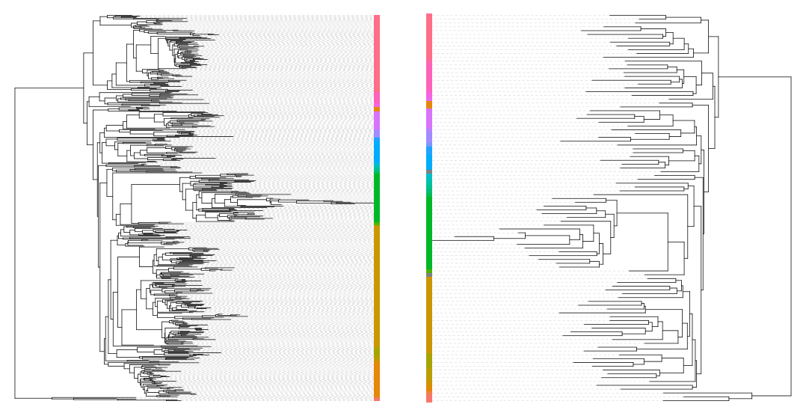
Go further : phyloseq smoothing
tip glom agglomerates otus at a given height in the tree.
mergedData <- tip_glom(food, h = 0.3)

Slide 126
Go further : rarefaction curves

Slide 127
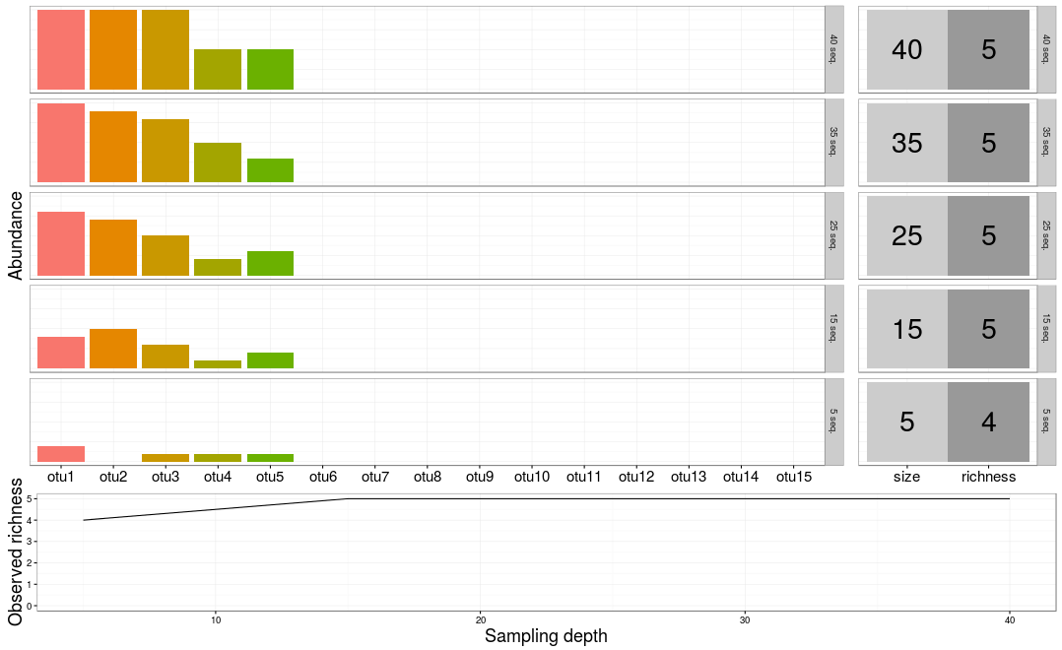
Go further : rarefaction curves
.. After filtering on rare OTUs

Slide 128
Go further : rarefaction curves
Why?
diversity indices are heavily influenced by sampling depths.
Rarefaction curves assess if sampling has exhausted the diversity.
How?
Rarefy all samples to the same depth (optional, for speed here);
Use custom function ggrare and specify a step size.
food <- rarefy_even_depth(food, rngseed = 1121983)
p <- ggrare(food, step = 1000, color = "SampleType", se = FALSE)
To distinguish different environments easily, use facetting (and plain background)
plot(p + facet_wrap(~EnvType) + theme_bw())

Slide 129
Go further : rarefaction curves

Slide 130
Go further : rarefaction curves

Slide 131
Go further : use your own color palette
We already order the food types to make graphs easy to read:
## [1] "BoeufHache" "VeauHache" "DesLardons" "MerguezVolaille"
## [5] "SaumonFume" "FiletSaumon" "FiletCabillaud" "Crevette"
Likewise, we're going to use a custom color palette
foodPalette <- c("#67001f", "#b2182b", "#d6604d", "#f4a582", "#92c5de", "#4393c3", "#2166ac", "#053061")
names(foodPalette) <- levels(sample_data(food)$EnvType)

Slide 132
Go further : use your own color palette
Try this palette on clustering plot
## Map sample type to color
tipColor <- col_factor(foodPalette, levels = levels(envtype))(envtype)
## Change hclust object to phylo object and plot
clust.uf <- as.phylo(hclust(dist.uf, method = "ward.D2"))
plot(clust.uf, tip.color = tipColor, direction = "downwards", main = "Ward linkage")

Slide 133
Go further : use your own color palette
Try this on any ggplot
food <- rarefy_even_depth(food, rngseed = 1121983)
p <- ggrare(food, step = 1000, color = "EnvType", se = FALSE)
p <- p + facet_wrap(~EnvType, ncol = 4) + theme_bw()
p <- p + scale_color_manual(values = foodPalette)
plot(p)

Slide 134
Go further : heatmap order
custom otu order in function of prevalence
prevalence <- estimate_prevalence(food,"EnvType")
get in a different format to estimate correlations
correlationData <- estimate_prevalence(food, "EnvType", format = "wide")
correlationData <- t(correlationData)
correlation <- cor(correlationData, method="pearson")
clustering sample and order otu according to the tree
otu.clust <- hclust(as.dist(1-c), method = "complete")
otuOrder <- otu.clust$labels[otu.clust$order]
plot
p <- plot_heatmap(food, taxa.order = otuOrder)
p <- p + facet_grid(~EnvType, scales = "free", space = "free")
p <- p + scale_fill_gradient2(low="#1a9850", mid = "#ffffbf", high="#d73027", na.value = "white", trans = log_trans(4), midpoint = log(100,base= 4 ))
plot(p)

Slide 135
Go further : heatmap order

